Slide 1
MAKÓ, 2013
Presentation of the
Dancsi és Társa KFT.
Notes:
Good Morning Ladies and Gentleman. Let me introduce our selves. Mr. István Dancsi sr. is the director of the company. My coleague is Radiszláv Neducza logistic manager. I am Erzsébet Szél transport organiser. Please take a copy of our presentation.

Slide 2
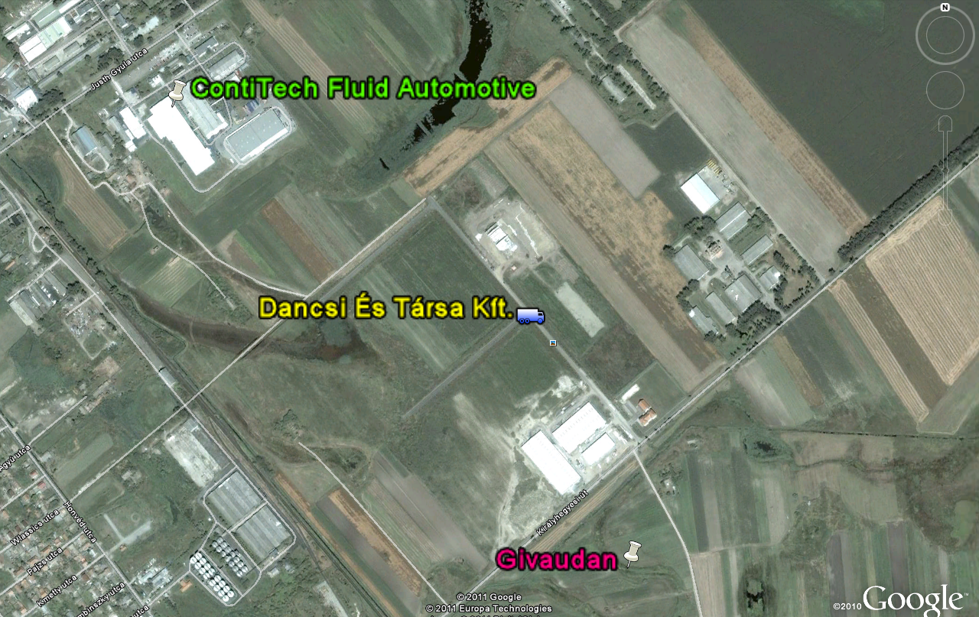
DANCSI ÉS TÁRSA KFT. LOCATION

Slide 3
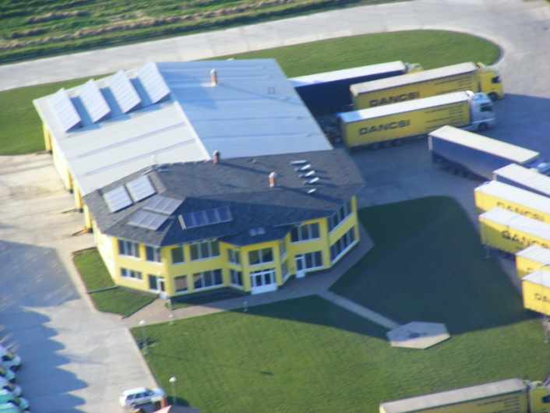
I. COMPANY HISTORY
Dancsi és Társa Kft.
Established in 1993
Headquarters: Makó
Activities: complex logistic solutions, forwarding
Main Profile: International Transport
Partner company: FAVOR TRANS Kft. (since 1998)
Started with express flights
On increased customer demand freight transportation with vans and trucks followed
The fleet is constantly modernised, services have been expanded
Notes:
First i wolud like to talk about the history of our company. Our H.Q. is int he industrial park of Makó. Our activities include complex logistic solution. And forwarding cargo tailord to the needs of our clients. We have a partner company. Which was established in 1998. Bí mr. i.d. jr. we wanted to separate different tasks int he two companies. It started express flights with smaller vans later the services were extended by larger vans and trucks.

Slide 4
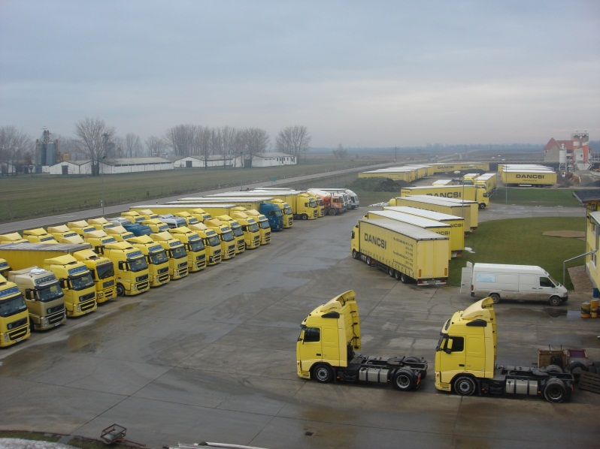
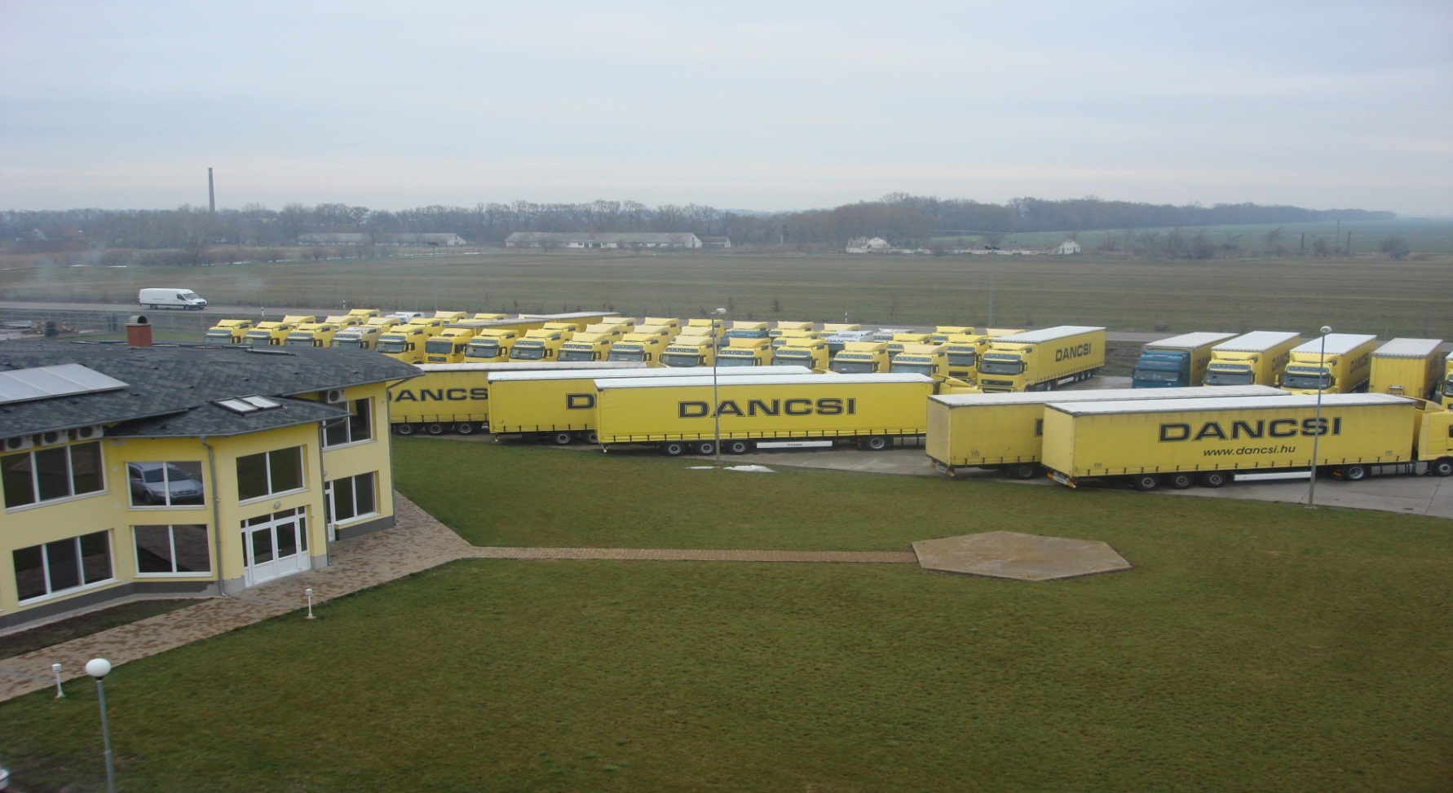
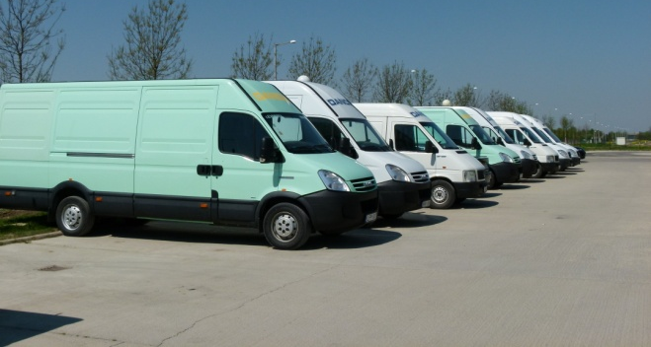
II. FLEET (1.)
Main target: To ensure the most modern and well equipped fleet for our partners
Notes:
In this slide you can see the different types of vehicles.

Slide 5
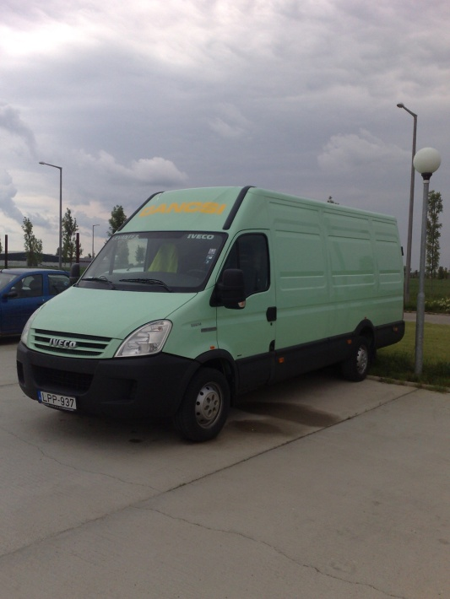
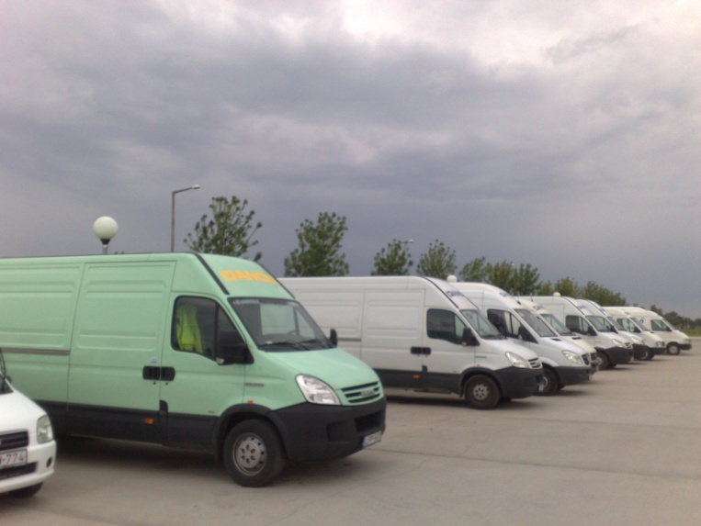
II. fleet (2.)
CURRENTLY WE OFFER:
2 pce van /17,2 m³/
2 pce van /15,4 m³/
2 pce vans /12,8 m³/ for rent
2 pce cargo trucks, Iveco 7,5t /40 m³/
Average age 2 years
Notes:
Now most you can see details of some of the smaller vans and trucks. They are used for express forwarding.

Slide 6
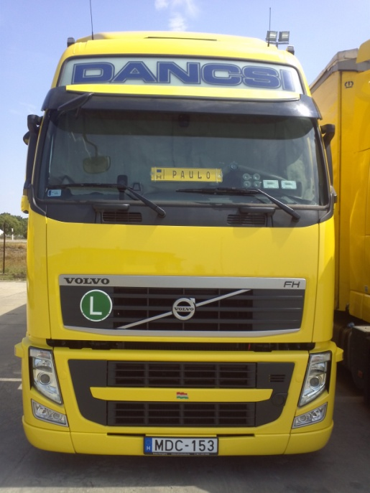
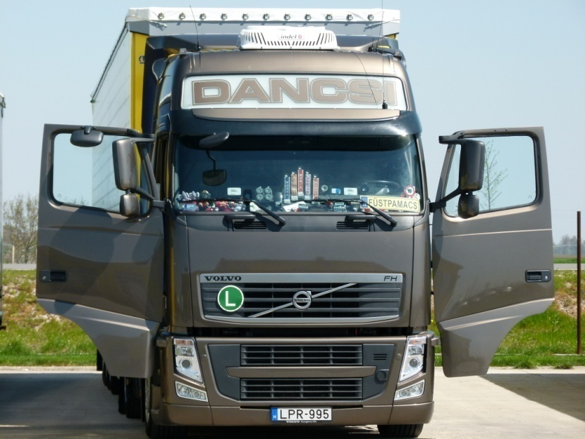
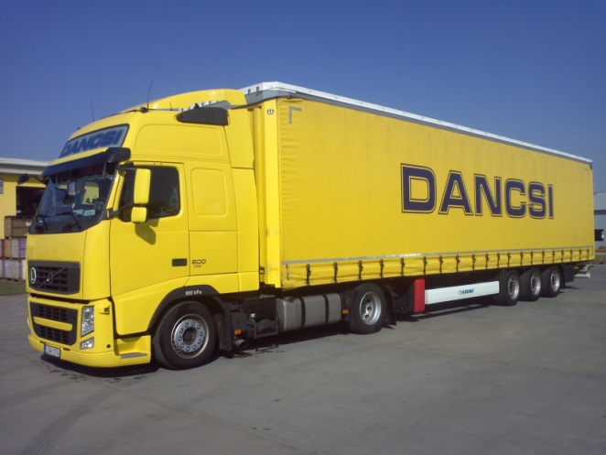
II. FLEET (3.)
70 pce megatrailer (3m high) /102 m³/
8 pce standard trucks /95 m³/
Notes:
Now most you can see details of some of the smaller vans and trucks. They are used for express forwarding.

Slide 7
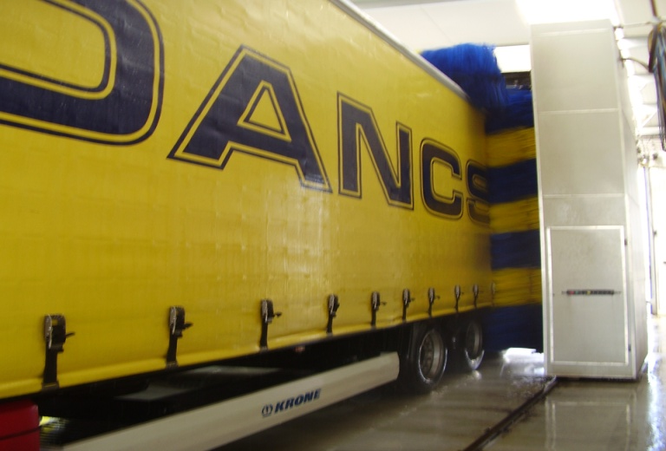
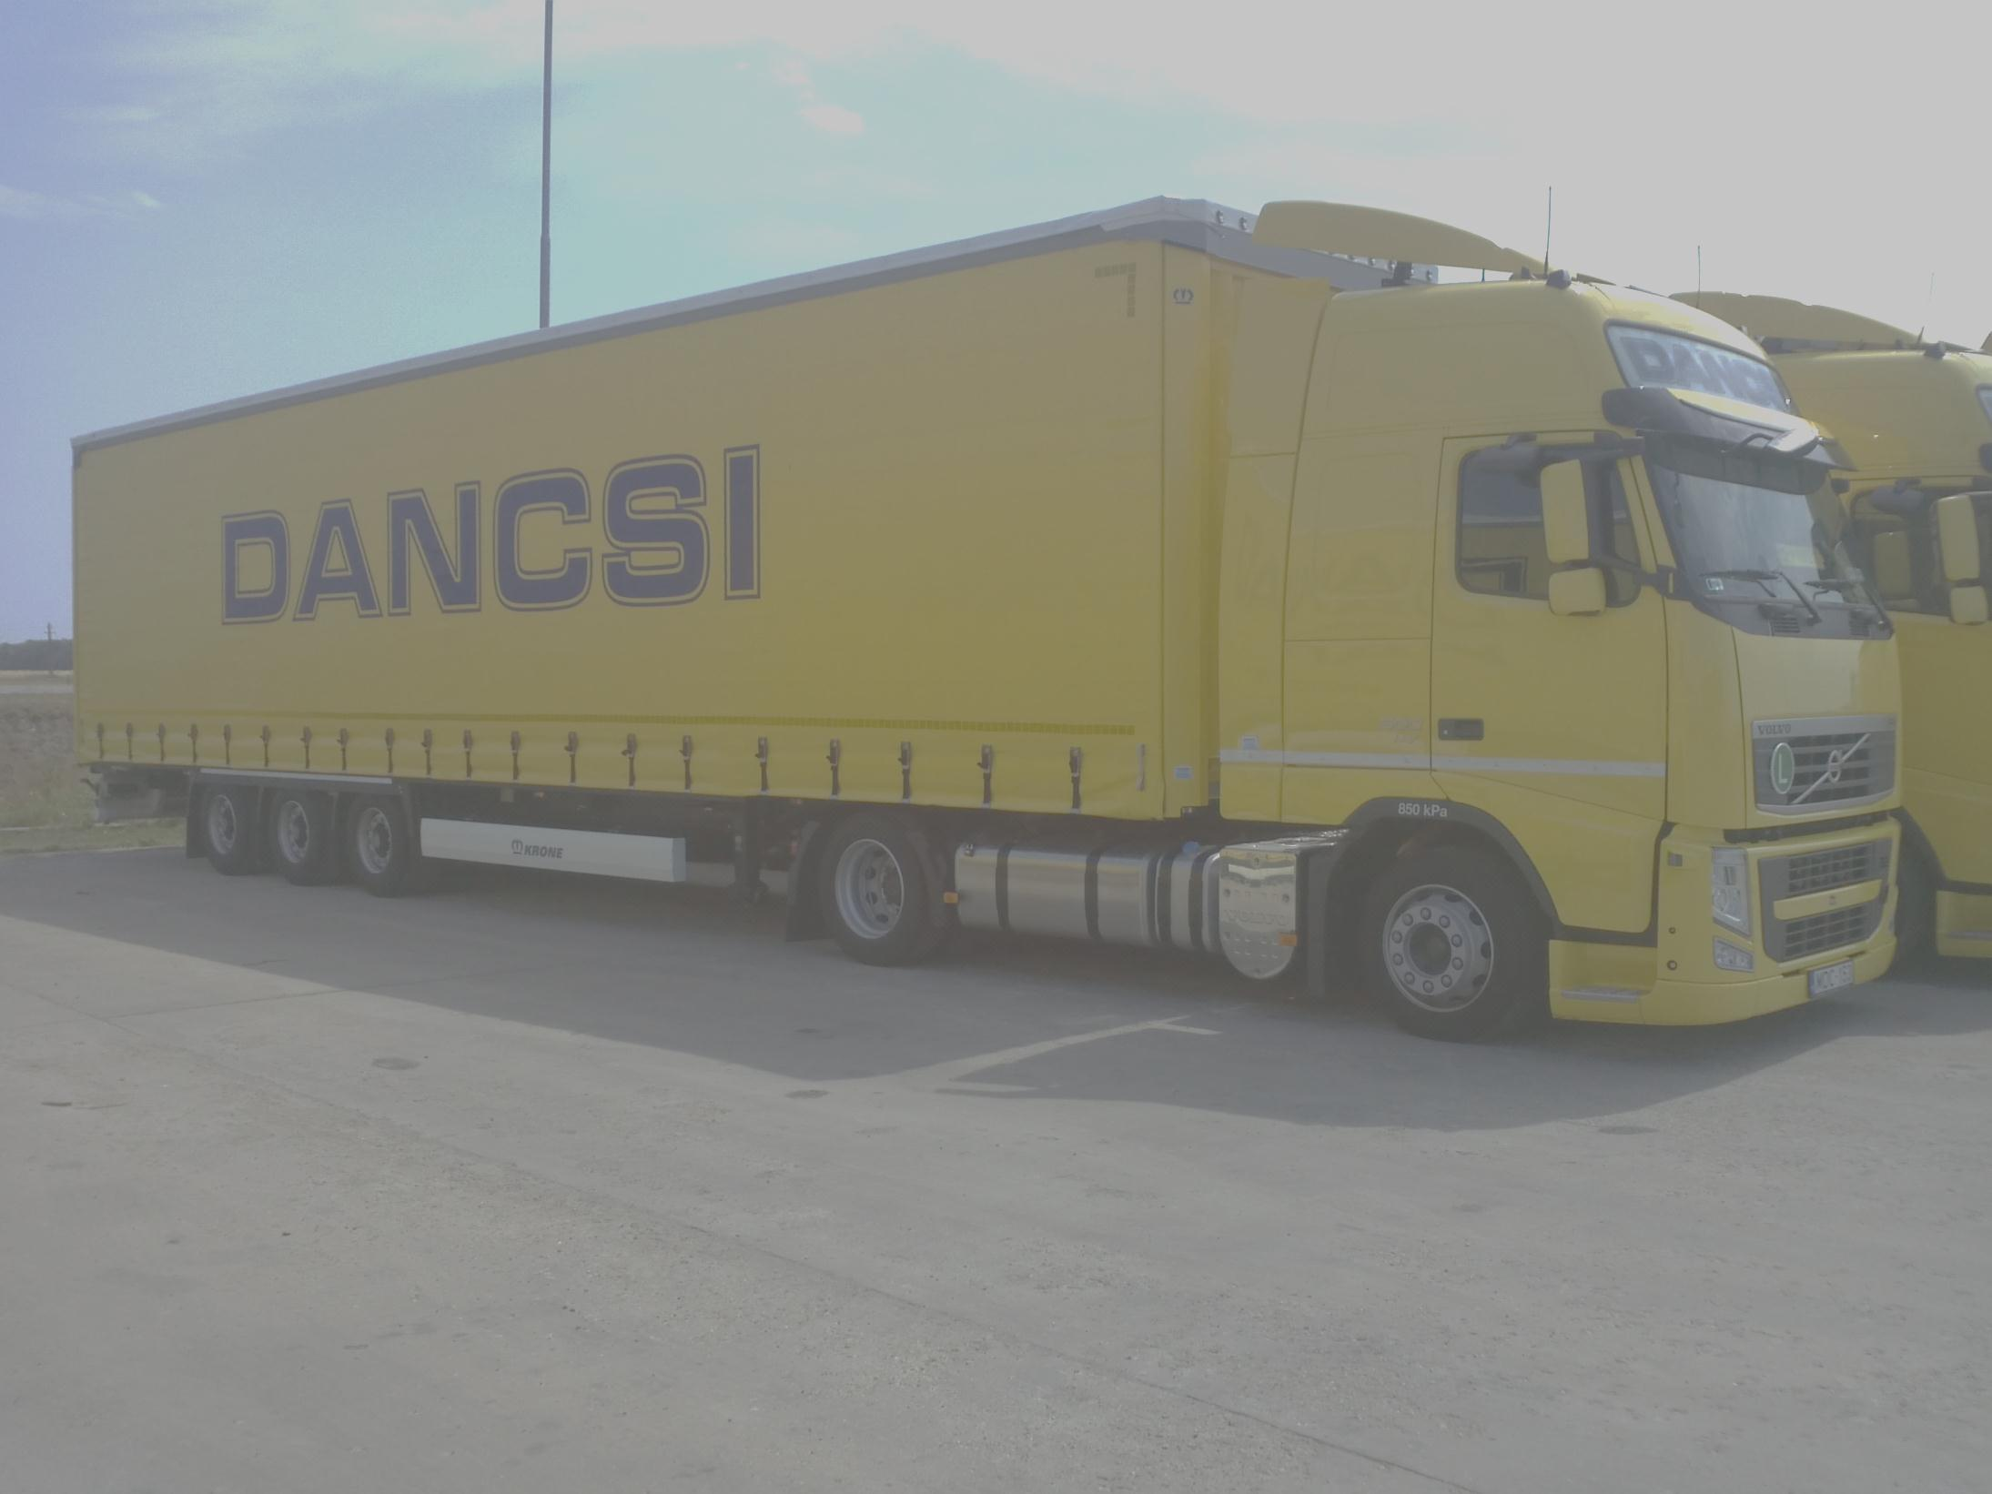
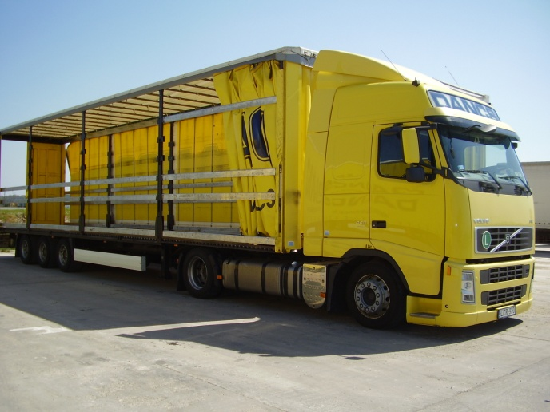
II. JÁRMŰPARK (4.)
Trailers (104 pce)
43 pce KRONE CODE XL, mega /102 m^{3/}
produced in 2011/2012
16 pce KRONE , mega /102 m^{3/}
average age 4 years
30 pce Schmitz, mega /102 m^{3/}
average age 5 years
6 pce Schwarzmüller, mega /102 m^{3/}
average age 5 years
6 pce Schwarzmüller, standard /95 m^{3/}
average age 5 years

Slide 8
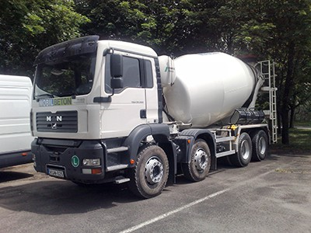
II. FLEET (5.)
6 pce BETON-MIXERS
Notes:
We bought six concrete mixers to serve the needs in the industrial park. Write now all of them are used at your constuction site.

Slide 9
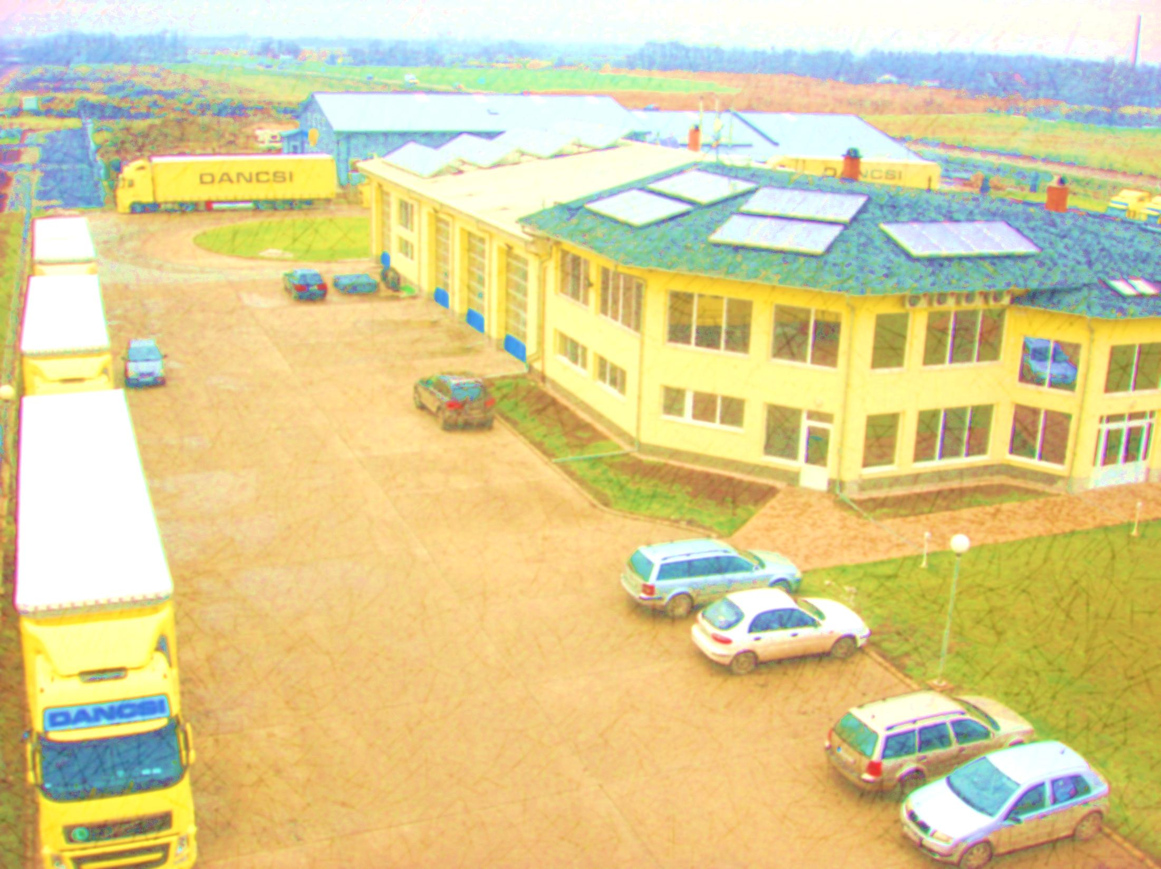
II. FLEET SUMMARY (6.)
70 db megatrailers (3m hight)
→ 25 pce EURO 5
→ 45 pce EURO 5 EEV
8 pce standard trucks (2,8m hight)
6 pce vans
2 pce cargo trucks , Iveco (7,5t)
6 pce beton mixer
In total 92 freight transport vehicles
Avarage age: 2 years
Notes:
Finally - you can see a summary of all of our freight vehicles.

Slide 10
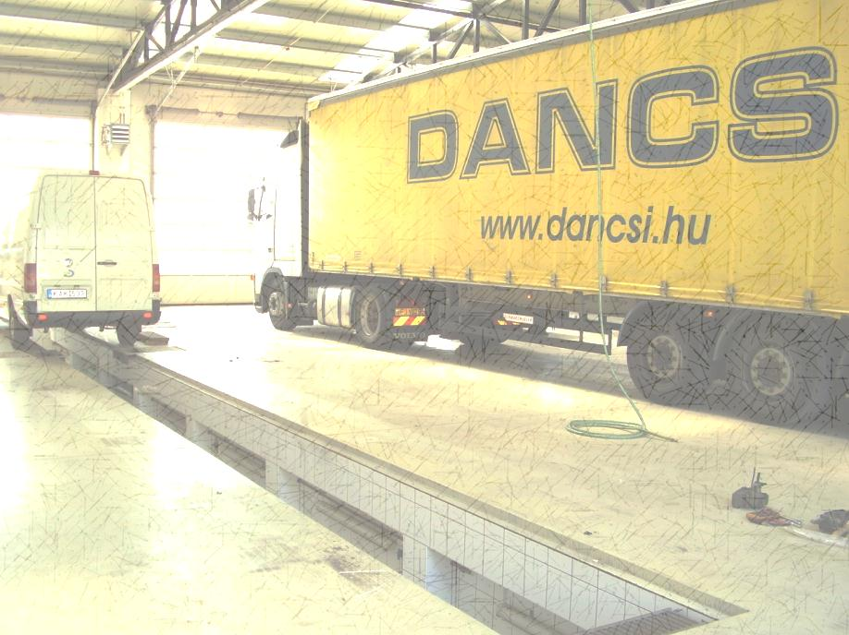
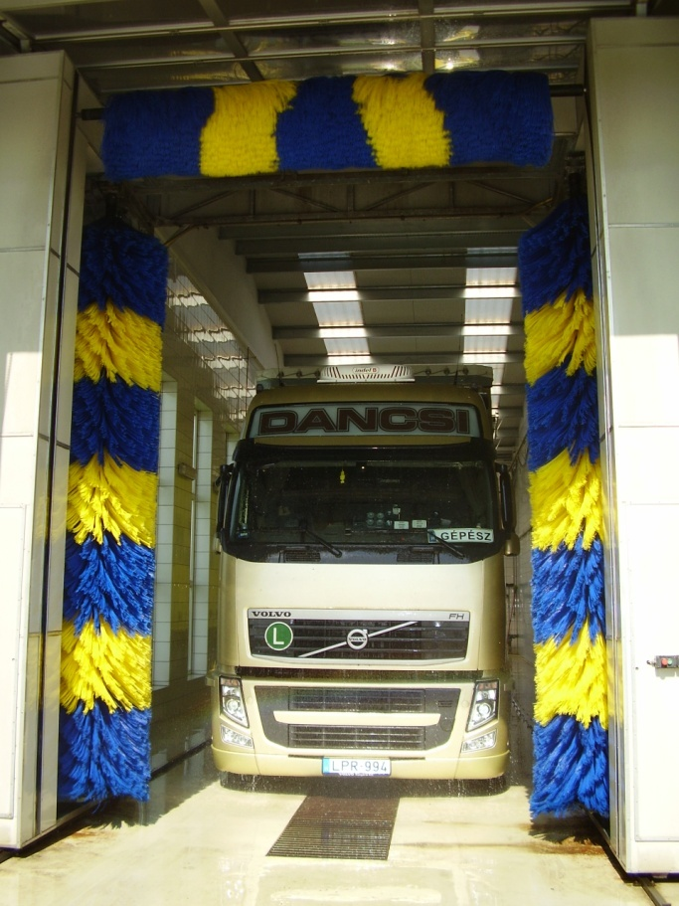
II. FLEET – SERVICE
Technical reliability of our vehicles is guaranteed by:
Our own service depot and workshop with regular repair and maintenance work
Notes:
We have a depot and workshop with well trained mechanics to ensure maintenance and reliability.

Slide 11
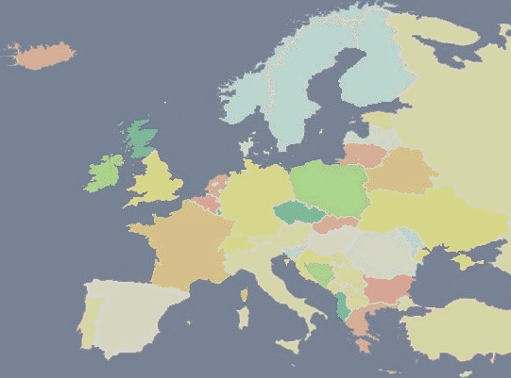
III. OUR SERVICES (1.)
Main Profile: International Transportation
Main destinations:
Austria
Germany
Belgium
Netherlands
England
France
Switzerland
Italy
Spain
Portugal
Denmark
Romania
Notes:
We transport goods to practicaely everywhere in europe.

Slide 12
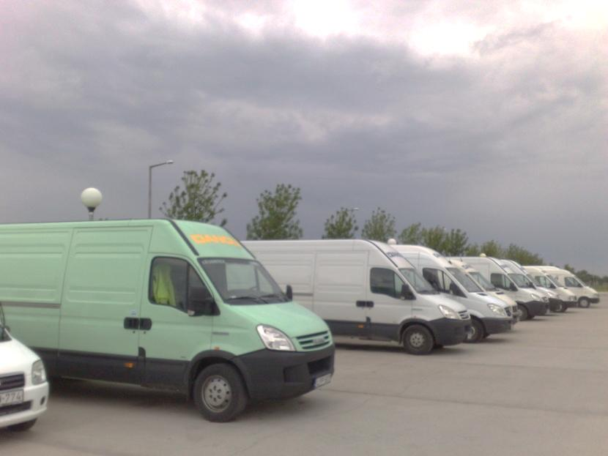
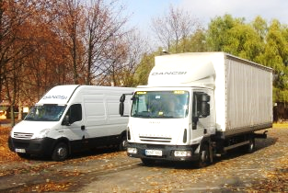
III. OUR SERVICES (2.)
Express freights (with 1 or 2 drivers)
Mostly to international destinations

Slide 13
III. OUR SERVICES (3.)
ELECTRONIC VEHICLE TRACKING:
Acces to our satellite tracking systems web interface
Accurate shipment tracking updated every second
Each vehicle equipped with navigation system
There is a constant communication link between the vehicle and the organizer, wich makes the delivery of goods easier and quicker
We take all domestic and international regulations seriously
Notes:
Our cliens get a free web interface to track shipments. The data is automatically updated. So you can access current information. We constantly communicate with the drivers to ensure prompt delivery.

Slide 14
IV. INVESTMENTS 2012 (1)
Fleet enlargement:
20 EURO 5 EEV type tractor (500 horsepower)
20 KRONE, CODE XL type megatrailers
Investment completed
Notes:
We dont only invest in the new warehouse but will have 20 new trucks this year. We already received ten of those. As you noticed the average age of our trucks is two years. A modern fleet is important to ensure quality services.

Slide 15
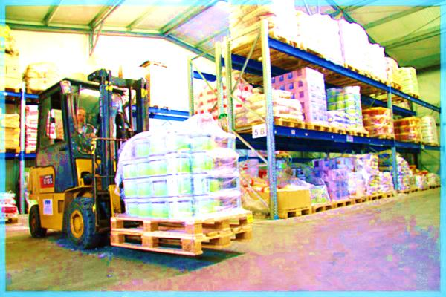
IV. Investment for 2014 (2)
Some additional services for our partners:
STORAGE:
3000 m² warehouse space, with 9 m heigh, insulated storage area (being implemented)
Tools and equipment wich are required for warehouse logistics
The company is ready to purchase some new facilities, to meet the needs of new clients
Notes:
We can provide additional services. Our 3,000 square meter warehouse is being implemented now. It will provide 9 m high insulated storage area.

Slide 16
V. REFERENCE
We are one financially strong company, with many years of outstanding professional work experience
You can check the quality of our operation by the following references:
Mercedes
BMW
Volkswagen
DHL Freight Hungary: Several years of cooperation
ContiTech Fluid Automotive HU Kft.: Since its founding, the company conducted regular international transports for them
Váll-Ker Kft.
V.G.M. MAGÉP Gépgyártó Kft.
Express and normal deliveries for them
Notes:
As you can see from the company history and ongoing projects. We are a strong company with the largest and most modern fleet int he region. You can read the names of some important international and local partners.

Slide 17
VI. CONTACT (1.)
Dancsi és Társa Kft.
Director: István Dancsi, Sr.
Address: 6900 Makó, Ipari park 12209 hrsz.
Phone: 00 36/62 511 110
Fax: 00 36/62 511 115
Mobile: 00 36/30-938-3444
E-mail address: dancsi.i@vnet.hu / dancsi@dancsi.hu
Web: www.dancsi.hu
Favor Trans Kft.
Director: István Dancsi, Jr.
Address: 6900 Makó, Ipari park 12209 hrsz.
Phone: 00 36/62 511 110
Mobile: 00 36/30-555-0005
E-mail address: dancsi78@dancsi.hu
Notes:
Please find our contact information ont he rest of the slides and int he brochures.

Slide 18
VI. CONTACT (2.) logistics
Logistics Manager:
Radiszláv Neducza
Phone: 00 36/62 511-106 Mobile: 00 36/30 555-000-3 Fax: 00 36/62 511-114 E-mail address: radiszlav@dancsi.hu Spoken languages: German, English, Serbo- Croatian

Slide 19
VI. CONTACT (3.) logistics - transport organization
Edit Hadár:
Phone: 00 36/62 511-111 Mobile: 00 36/30 555-000-1 Fax: 00 36/62 511-113 E-mail address: hadar.e@dancsi.hu
Péter Mészáros:
Phone: 00 36/62 511-116 Mobile: 00 36/30 555-000-4 Fax: 00 36/62 511-105 E-mail address: meszaros@dancsi.hu

Slide 20
VI. CONTACT (4.) logistics - transport organization
Péter László Kaszián:
Phone: 00 36/62 511-117 Mobile: 00 36/30 965-6666 Fax: 00 36/62 511-105 E-mail address: kaszian@dancsi.hu Spoken language : English
Erzsébet Szél:
Phone: 00 36/62 511-103 Mobile: 00 36/30 555-000-2 Fax: 00 36/62 511-114 E-mail address: szel@dancsi.hu
Spoken languages: German, English

Slide 21
VI. CONTACT (5.) financial - accounting
Ildikó Joó:
Phone: 00 36/62 511-101 Fax: 00 36/62 511-119 E-mail address: jooildiko83@gmail.com Spoken language: German

Slide 22
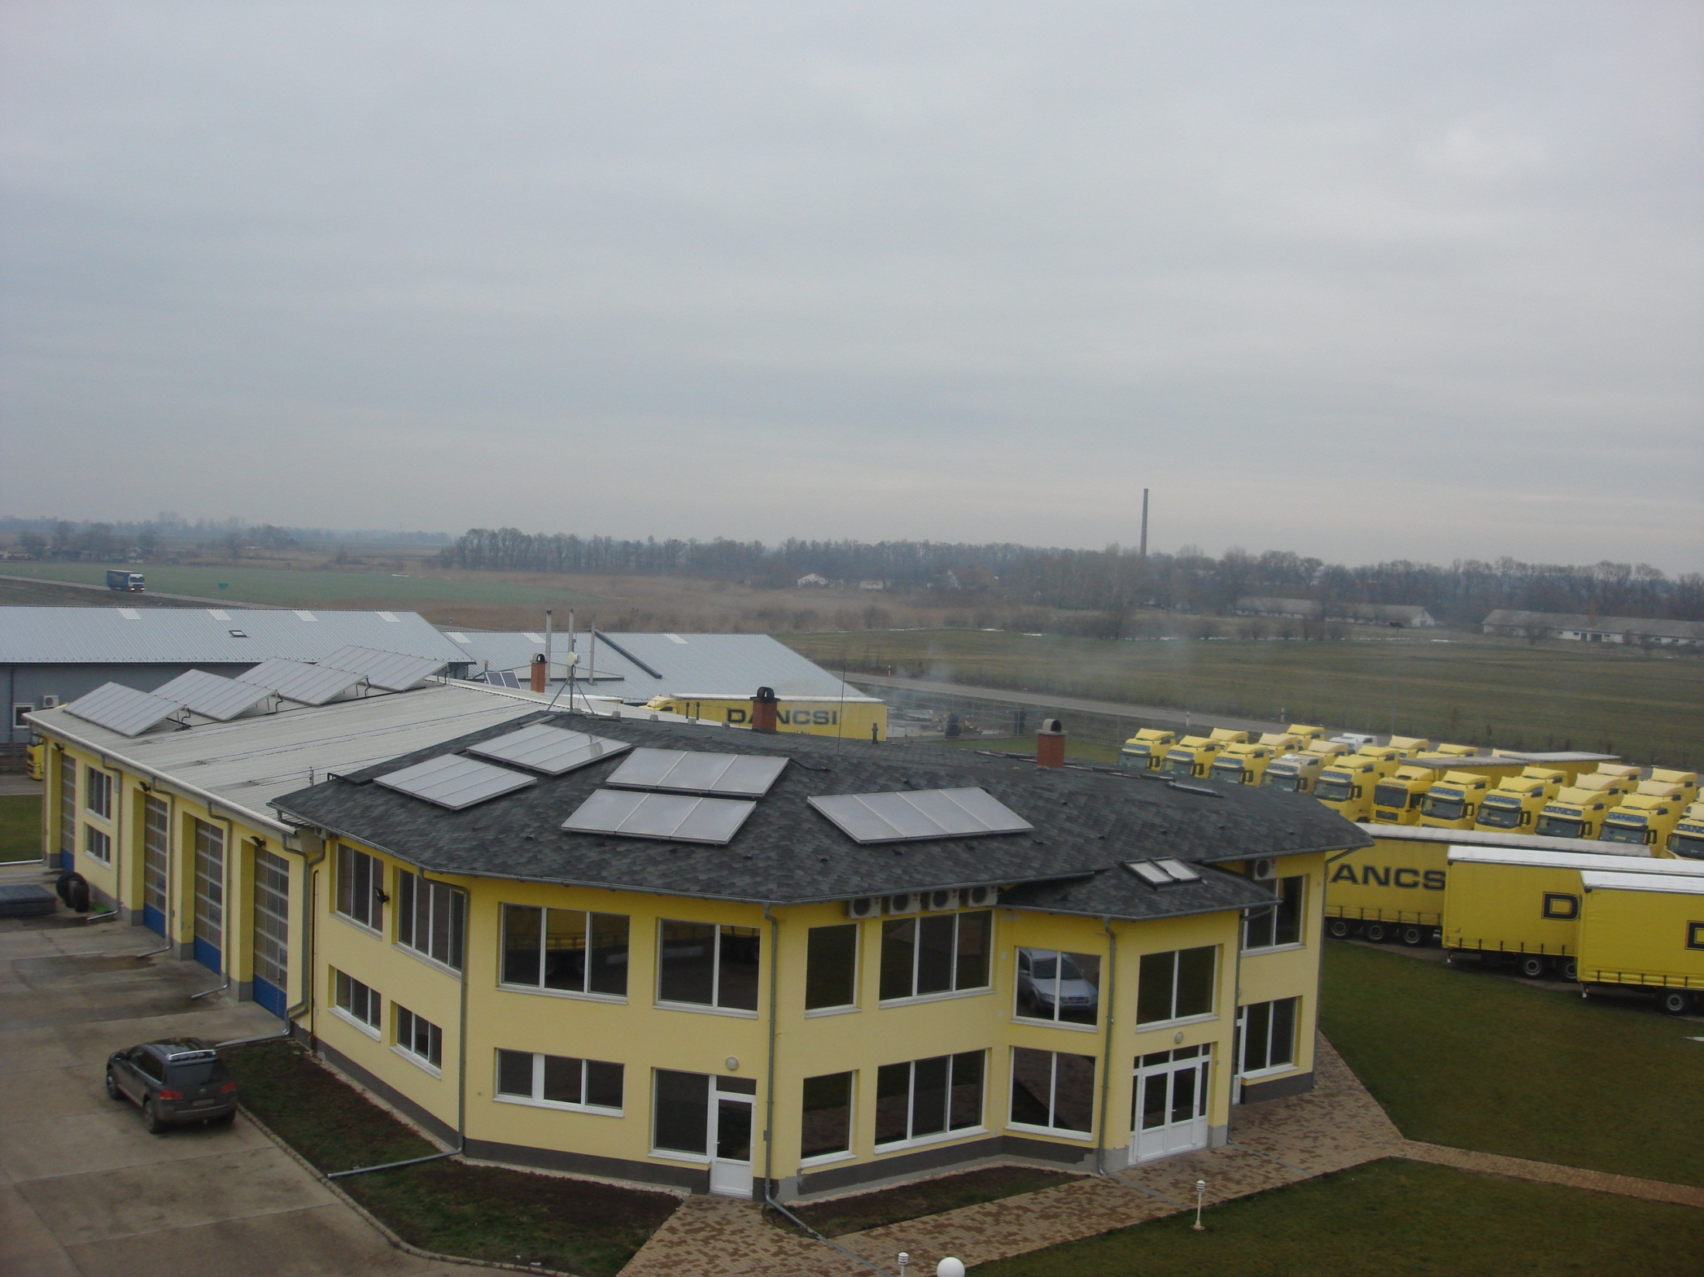
If you would like any further information, please don’t hesitate to contact us!
www.dancsi.hu

Slide 23
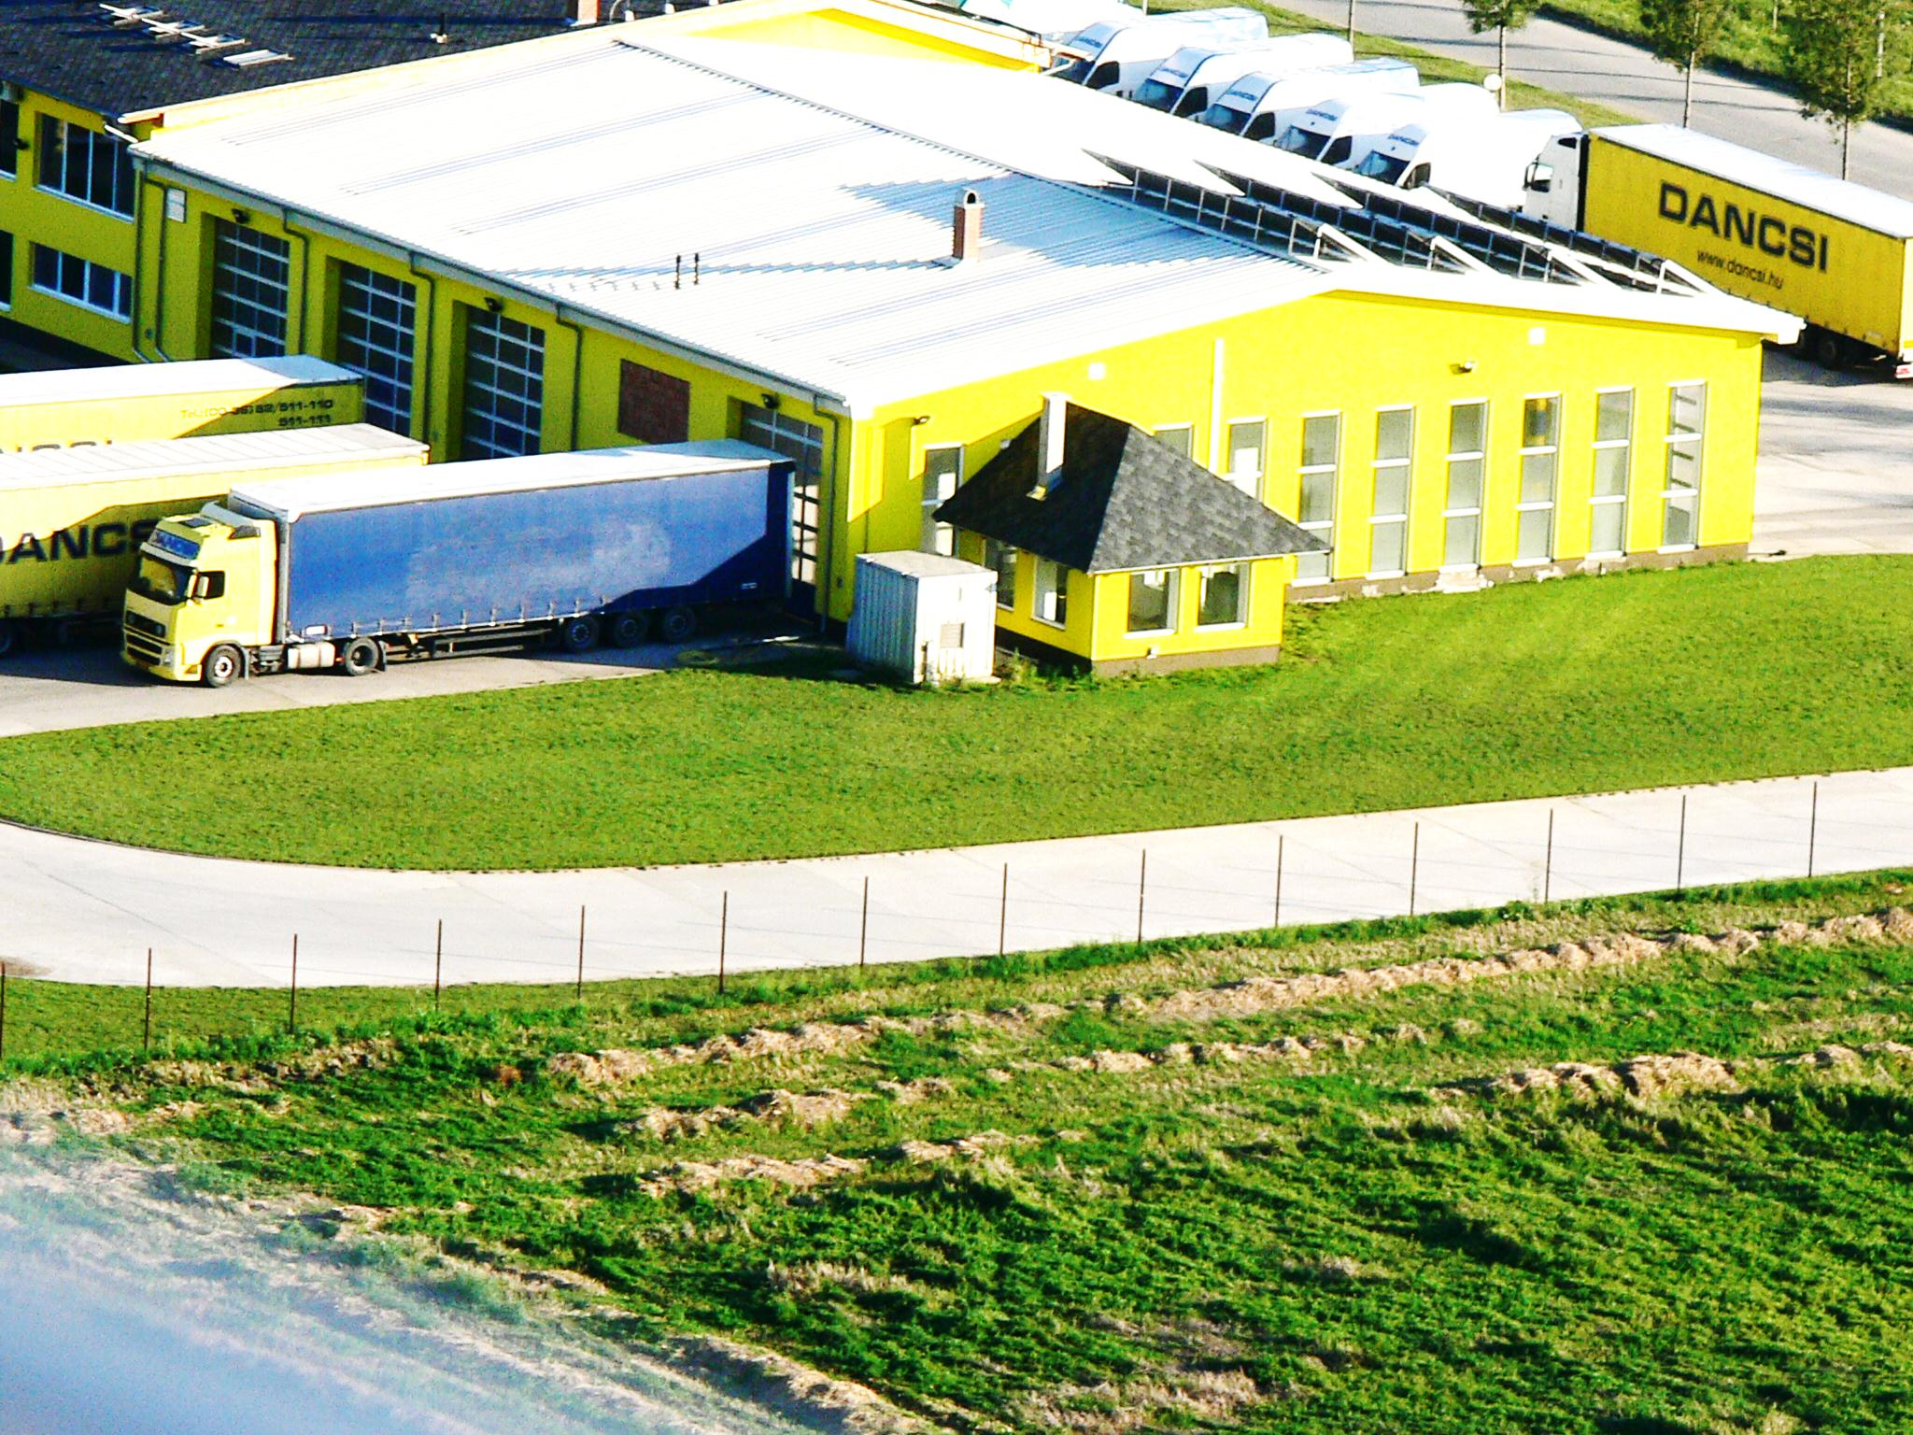
Thank you for your attention!

